Slide 1

DEPARTMENT OF ELECTRONICS AND COMMUNICATION
TEAM MEMBERS
PIRIYADHARSHINI.E (113321106067) NIVETHA.S(113321106065) RADHIKA.G(113321106072) SARANYA.S(113321106084)

Slide 2
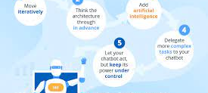

Slide 3
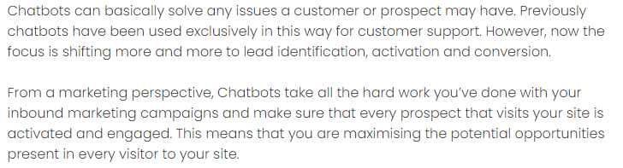
PROBLEM DEFINITION

Slide 4
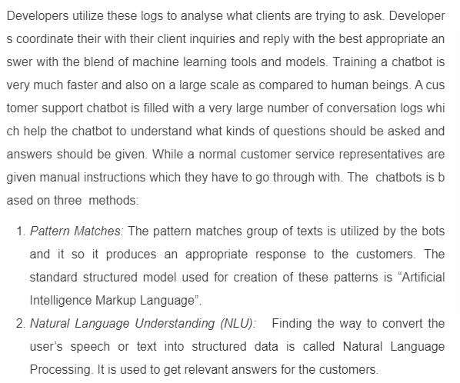
OBJECTIVES

Slide 5
How can we do innovations in chatbot
Innovating with chatbots in Python involves incorporating advanced features, technologies, or approaches to enhance the user experience and functionality. Here's a step-by-step guide on how you can implement innovations with a chatbot in Python:
Define Objectives:
Clearly outline the goals and objectives of your chatbot. Understand the specific problems it aims to solve or the tasks it should perform.
2 . Select a Framework or Library:
Choose a suitable Python framework or library for building your chatbot. Popular choices include ChatterBot, Rasa, and NLTK.
3 . Implement Natural Language Processing (NLP):
Enhance the chatbot's ability to understand and generate human-like responses by implementing advanced NLP techniques. Utilize pre-trained models like spaCy, BERT, or GPT.

Slide 6
5 . Voice Interaction:
Implement speech recognition using libraries like Speech Recognition. Integrate text-to-speech capabilities to enable voice interactions with the chatbot.
6 . Sentiment Analysis:
Use sentiment analysis libraries to gauge the user's emotions during the conversation. Adjust the chatbot's responses based on the detected sentiment
7 .Interactive Media and Rich Content:
Enable the chatbot to handle images, videos, and other rich media content. This can enhance user engagement, especially in scenarios where visual communication is important.
8 . Educational Chatbot Features:
If your chatbot is for educational purposes, implement features such as answering questions, providing explanations, and offering interactive quizzes.

Slide 7
Development of chatbot using python
Developing a chatbot using Python involves several steps, from designing the conversational flow to implementing natural language processing (NLP) and integrating it into your application. Here's a general roadmap to create a simple chatbot using Python:

Slide 8
Define the Purpose and Use Case:
Determine the goal and functionality of your chatbot. What will it assist users with? What problem will it solve?
Choose a Framework or Library:
Python offers several libraries and frameworks for building chatbots. Popular choices include:
NLTK (Natural Language Toolkit): For NLP and text processing.
spaCy: Another NLP library.
ChatterBot: A Python library that simplifies chatbot development.
Rasa: An open-source conversational AI platform.
Dialogflow or LUIS: Platforms that provide NLP and conversation management as a service.
Gather and Prepare Data:
For training your chatbot, you may need a dataset of conversational data or FAQs depending on the use case. Clean and preprocess the data as needed.

Slide 9
Natural Language Processing (NLP):
If you're not using a pre-trained chatbot platform, you'll need to implement NLP components. This includes:
Tokenization: Breaking text into words or sentences.
Named Entity Recognition (NER): Identifying entities like names, places, and dates.
Part-of-Speech Tagging: Assigning parts of speech to words.
Intent Recognition: Understanding user intentions.
Sentiment Analysis: Assessing the sentiment of user input.
Create a Chatbot Interface:
Build a user interface for your chatbot. This could be a web app, mobile app, or a command-line interface.
Chatbot Logic:
Implement the logic that guides the conversation. This typically includes handling greetings, user queries, and responses.
Train the Chatbot:
If you're using a library like ChatterBot, you can train your bot on your prepared dataset. For custom NLP solutions, train your models using the prepared data.

Slide 10
Conversation Flow:
Define how the chatbot flows from one user input to the next. Use state machines or similar techniques to maintain context.
Integration:
Integrate your chatbot with the chosen platform or interface. For example, if you're building a web-based chatbot, you can use Flask or Django for backend integration.
Testing and Debugging:
Test your chatbot extensively to ensure it responds correctly to a variety of inputs. Debug and refine its responses as needed.
Deploy Your Chatbot:
Deploy your chatbot to a server or cloud platform for public access.
Monitoring and Maintenance:
Continuously monitor and collect user feedback to improve the chatbot's performance. Update it with new responses, features, or improvements.
Scale and Optimize:
If your chatbot sees increased usage, optimize its performance and scalability as needed.

Slide 11
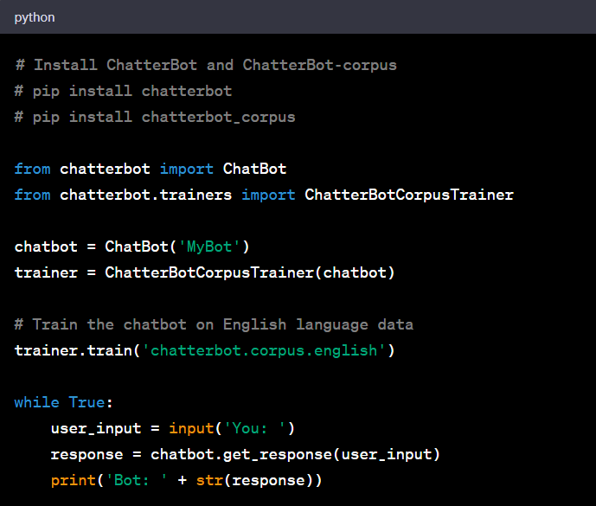
ANALYZING DATASETS USING PYTHON

Slide 12
DATASET FOR DEVELOPING CHATBOT USING PYTHON
When developing a chatbot using Python, the choice of dataset depends on the chatbot's purpose and the specific tasks it needs to perform. Here are some types of datasets that can be useful for different chatbot applications:
ChatterBot Corpus:
If you're using the ChatterBot library, it comes with a built-in corpus of conversational data in various languages that you can use for training.
Common Crawled Data:
Web scraped data from common sources such as Wikipedia, news articles, or discussion forums can be valuable for training a general-purpose chatbot.
Customer Support Data:
If your chatbot is designed for customer support or frequently asked questions, you can use past customer interactions and support tickets as training data.
Dialog Datasets:
There are various dialog datasets available for training chatbots, such as the Dialog System Technology Challenges (DSTC) datasets and the Persona-Chat dataset. These datasets contain conversational data and can be used for research and development.

Slide 13
4. Twitter or Social Media Data:
If your chatbot needs to understand and generate social media-like text, you can use Twitter data or other social media posts as a source.
5. Chat Logs:
Collect and anonymize chat logs from your own chat platform or messaging service (with user consent) to train a chatbot specific to your application.
6. Custom Collected Data:
1. Collect and annotate data specific to your chatbot's domain. This could include interactions from your website, app, or specialized industry sources.

Slide 14
MACHINE LEARNING ALGORITHM :
Developing a chatbot involves various choices in terms of machine learning algorithms, model training, and evaluation metrics. Here's an overview of each of these components:
Machine Learning Algorithms:
Natural Language Processing (NLP): Most chatbots are built on NLP algorithms. NLP encompasses a range of techniques for understanding and generating human language. Key components include tokenization, part-of-speech tagging, named entity recognition, and sentiment analysis. Popular NLP libraries like spaCy, NLTK, and Hugging Face Transformers are often used for this purpose.
Supervised Learning: Many chatbots start with supervised learning, where you provide a dataset of input text and corresponding responses. Algorithms like recurrent neural networks (RNNs), long short-term memory networks (LSTMs), and transformers (e.g., BERT) are employed to learn patterns in the data and generate responses.
Reinforcement Learning: For more advanced chatbots, reinforcement learning can be used. The chatbot interacts with users and receives rewards based on user satisfaction. This approach can be more complex to implement but can lead to more dynamic and context-aware responses.

Slide 15
4. Rule-Based Systems: Simple chatbots can be rule-based, where predefined rules and decision trees determine responses. While this approach is less flexible, it can be effective for specific use cases.
Model Training:
Data Collection: The first step is to collect a dataset of conversation examples. This dataset should ideally be diverse and representative of the kinds of interactions the chatbot will encounter.
Data Preprocessing: Data cleaning and preprocessing are essential to handle issues like noise in the data, missing values, and text normalization.
Feature Engineering: In NLP, feature engineering involves turning text data into numerical representations (e.g., word embeddings, TF-IDF vectors) that machine learning models can work with.
Model Architecture: Choose an appropriate model architecture, whether it's a recurrent neural network (RNN), LSTM, transformer, or a combination of these. The choice depends on the complexity of the chatbot and the available computational resources.

Slide 16
4. Rule-Based Systems: Simple chatbots can be rule-based, where predefined rules and decision trees determine responses. While this approach is less flexible, it can be effective for specific use cases.
Model Training:
Data Collection: The first step is to collect a dataset of conversation examples. This dataset should ideally be diverse and representative of the kinds of interactions the chatbot will encounter.
Data Preprocessing: Data cleaning and preprocessing are essential to handle issues like noise in the data, missing values, and text normalization.
Feature Engineering: In NLP, feature engineering involves turning text data into numerical representations (e.g., word embeddings, TF-IDF vectors) that machine learning models can work with.
Model Architecture: Choose an appropriate model architecture, whether it's a recurrent neural network (RNN), LSTM, transformer, or a combination of these. The choice depends on the complexity of the chatbot and the available computational resources.

Slide 17
5. Training: Train the model on the prepared dataset. This involves optimizing model parameters to minimize a defined loss function, such as cross-entropy for text generation tasks.
6. Hyperparameter Tuning: Experiment with different hyperparameters like learning rates, batch sizes, and model sizes to find the best-performing configuration.
Evaluation Metrics:
Perplexity: Perplexity is commonly used to evaluate the language model's ability to predict the next word in a sequence. Lower perplexity indicates better performance.
BLEU Score: The BLEU score measures the similarity between the model-generated text and reference text. It's widely used in machine translation but can be adapted for chatbots to assess the quality of responses.
ROUGE Score: ROUGE evaluates the quality of the model's responses by measuring overlap in n-grams between the generated and reference text. ROUGE is often used for text summarization and dialogue systems.

Slide 18
F1 Score: In the context of chatbots, the F1 score can be used to assess the model's performance in intent classification or named entity recognition tasks.
User Satisfaction Metrics: Ultimately, a chatbot's success is determined by user satisfaction. Collect user feedback and ratings to understand how well the chatbot meets user needs and expectations.
Human Evaluation: Conduct human evaluations where human judges assess the quality of chatbot responses. This provides qualitative insights into the chatbot's performance.
The choice of algorithm, model training, and evaluation metrics should align with the specific goals of the chatbot, the available data, and the desired user experience. Continuous monitoring and iterative improvements are crucial for chatbot development.

Slide 19
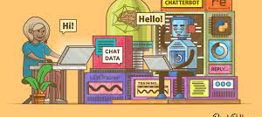
CHATTERBOT USING PYTHON

